Slide 1
Color Palette
#0D0D0D
#F2F2F2
#7ABFBF
rgba(122, 191, 191, .5)
#EB5428

Slide 2
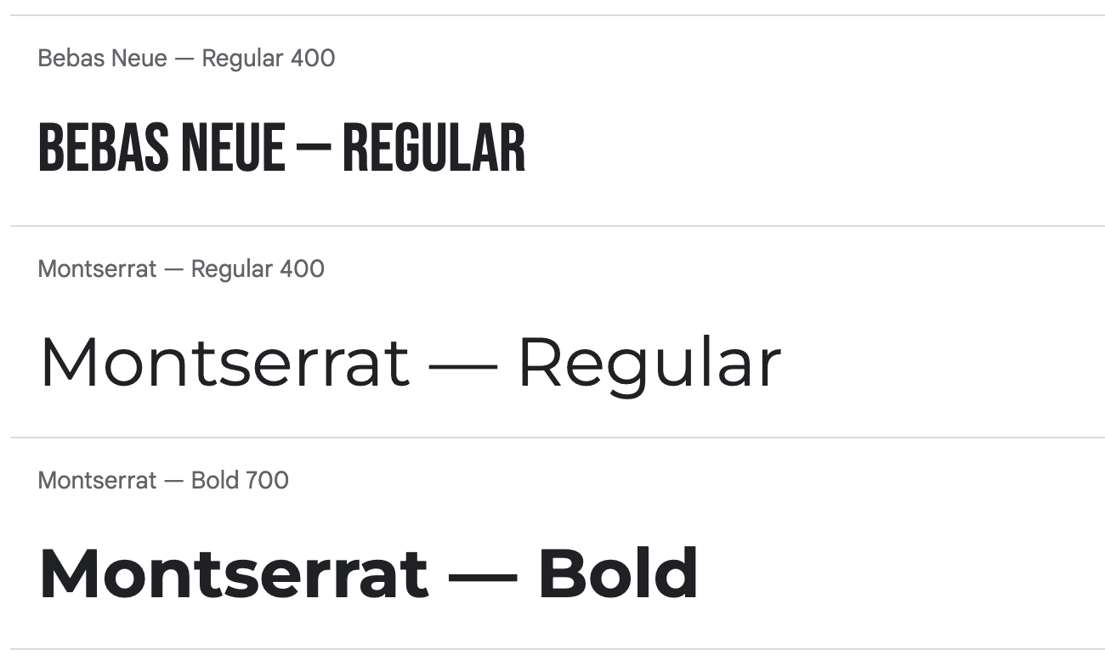
Typography
https://fonts.google.com/share?selection.family=Bebas%20Neue%7CMontserrat:ital,wght@0,400;0,700;1,400
H1- 40px
H2- 30px
H3- 25px
NAV A- 20PX
NAV SPAN- 20PX
FIGCAPTION- 20PX
MENU LI- 20PX
#SOCIAL LI- 20PX
FOOTER- 20PX
P- 16PX
DD- 16PX
LI- 16PX
NAV- 16PX INPUT- 16PX
DT- 16PX

Slide 3
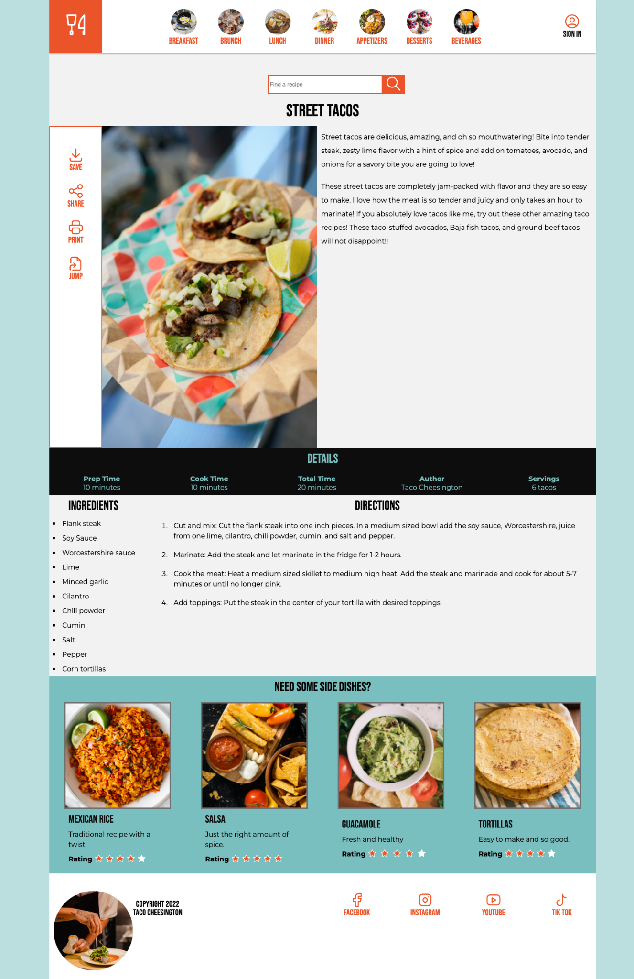
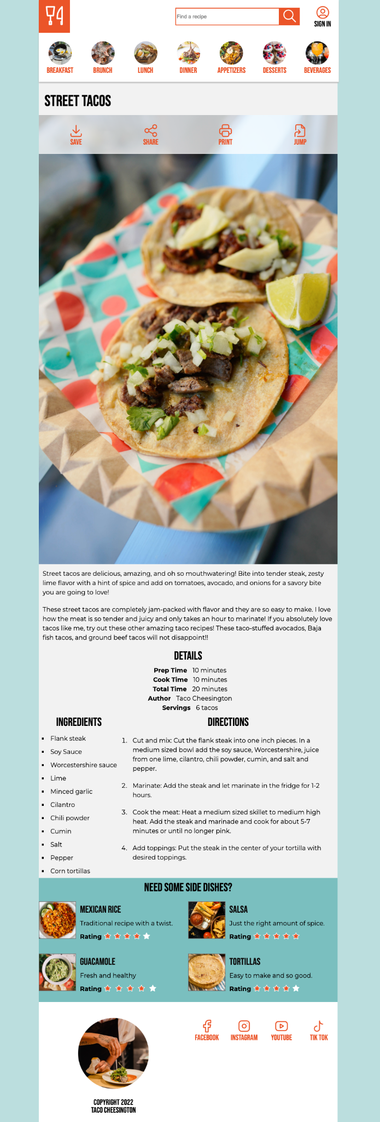
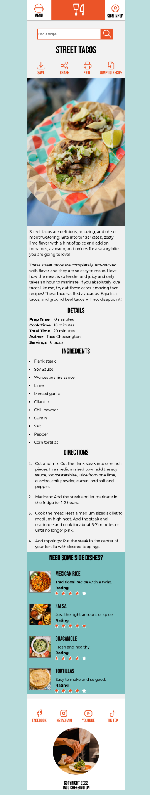
Responsive
* We haven’t learned responsive images or fonts yet (that will be in GIT 414), so we are just delivering one image for all the breakpoints and using % to size.
← 1280 px →
← 768 px →
← 414 px →

Slide 4
Front-End ONLY
* Our discipline doesn’t include server-side actions, so any content that requires it to function (sign in, form, star ratings), we’ll only to the front-end part.

Slide 5
MEGA HINTS
Same concept as the mobile nav from the last assignment
<menu>
https://developer.mozilla.org/en-US/docs/Web/HTML/Element/menu
Search Form
https://developer.mozilla.org/en-US/docs/Web/HTML/Element/input/search
No floats were used
<div> IS used a few times to group things for style reasons which is how it is intended
There’s about 500 lines of CSS code

